Slide 1
Urgent Exercise 12/9/2015
In your writing lab notes, think about and answer the following question:
What does “character’s world” mean?
What makes up a “character’s world?”

Slide 2
Character’s World
The world of a story is made of FOUR things:
1. people
2. places
3. things
4. ideas

Slide 3
#1- People: Major vs. Minor Characters
Major or central characters are vital to the development and resolution of the conflict.
The plot and resolution of conflict revolves around these characters.
Minor characters serve to complement the major characters and help move the plot events forward.

Slide 4
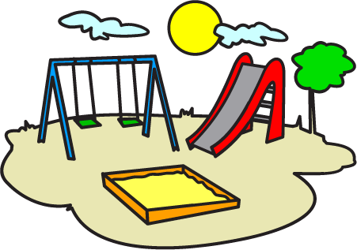
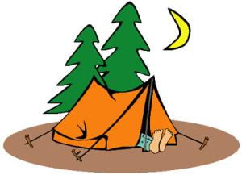
#2- Places
Places have meaning.
2. Describe places thoroughly so your readers get the meaning you intend.

Slide 5
#3- Things!
Important objects, entities, activities
2. Things have meaning
3. Symbolism

Slide 6
#4- Ideas
People tend to be more affected by something if they encounter it in a story they like.
People tend to remember things better if they figure them out for themselves.
Many important ideas like love, honor, courage, destiny, etc.
People are more apt to listen to serious things that others have to say if the message is wrapped in something entertaining.
IDEAS = THEMES (abstract concepts that are related to human emotions).

Slide 7
You will now…
Create an outline for each of the four aspects of your character's world.
2. If you need to create minor characters, now is the time to do so.
3. Ms. Ruberto will be circulating to conference.

